Slide 1
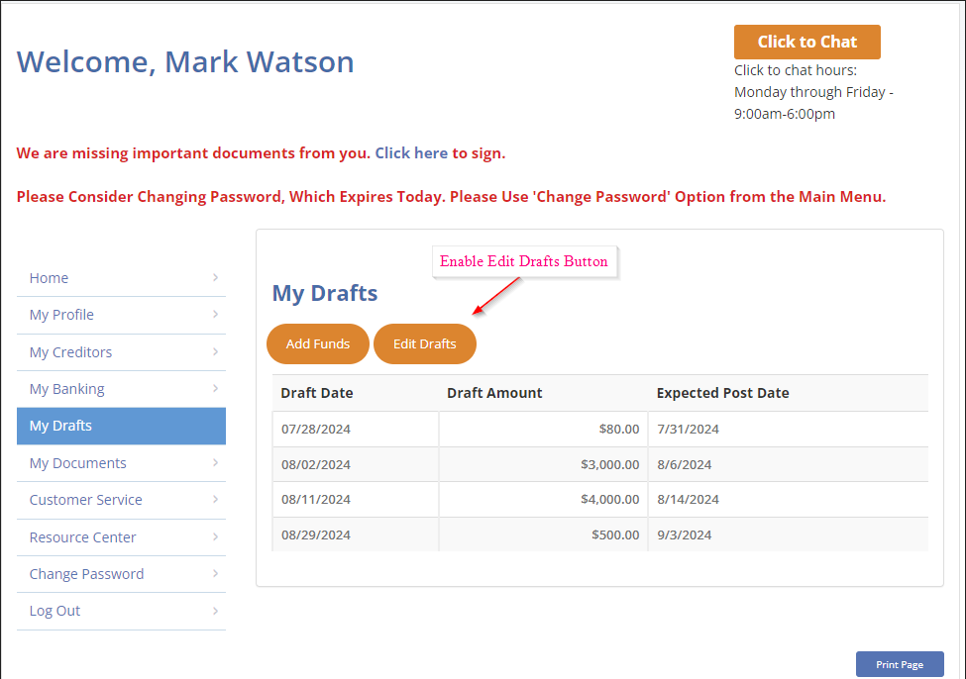

Draft Edits via Portal
Actions:
The system should no longer suggest reducing the draft amount or number of drafts when adding a new debt, regardless of the client’s available funds.
Changes to draft amount or program length made in the program change section should automatically update in the client’s ledger, eliminating the update in the draft or schedule change section.
The system will only allow an unmatched agent to add a max of 12 drafts to the client's program.
Client Portal View

Slide 2
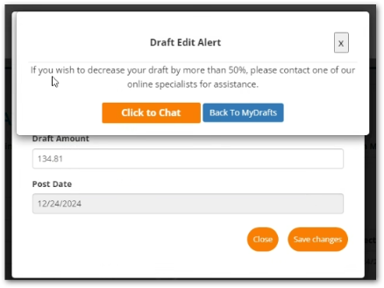
Draft Edit Alert
If the client attempts to lower the draft by more than 50%, the client will be directed to reach out via chat for further assistance with request.

Slide 3
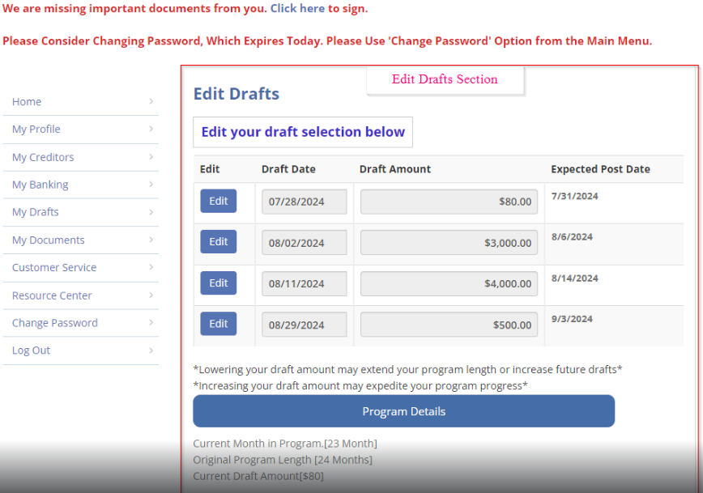
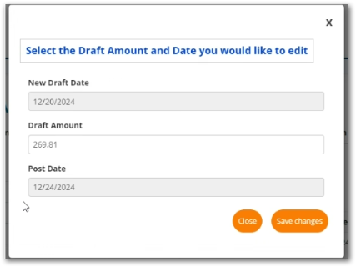
Edit Drafts
Here is where client has the ability to edit their drafts and schedule based on their personal needs.
Skip Drafts
Clients will no longer have the ability to skip their drafts through the portal.

Slide 4
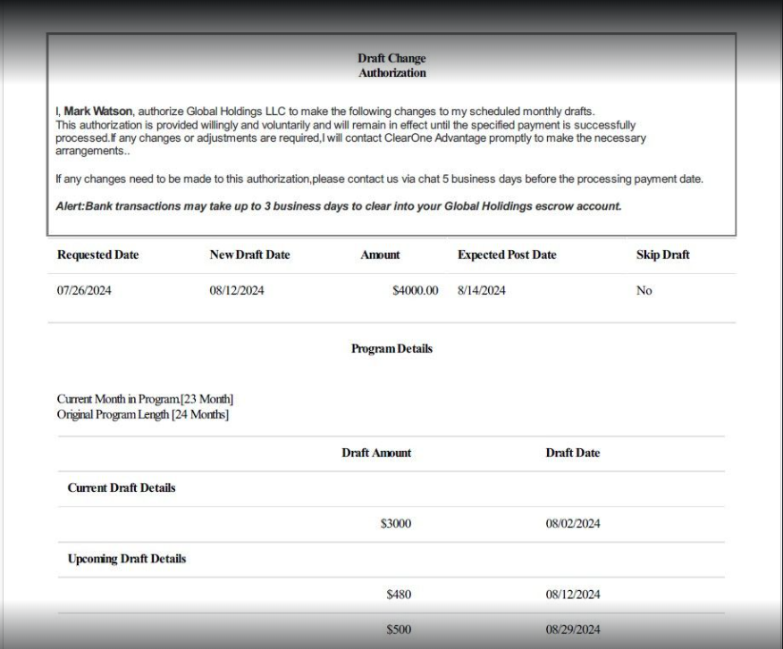
Draft Change Authorization
0nce the client has completed their edits they will receive a confirmation email and the
Daft Change Authorization will be uploaded to their client files.

